Slide 1


TRƯỜNG ĐẠI HỌC GIAO THÔNG VẬN TẢI UNIVERSITY OF TRANSPOST AND COMMUNICATIONS
Chapter 7: Caching

Slide 2

Notes:
Phương pháp tiếp cận hướng đối tượng
Trong Python, chúng ta có thể tạo các lớp tùy chỉnh được tích hợp đầy đủ và có thể được sử dụng giống như các kiểu dữ liệu tích hợp sẵn. Chúng ta đã gặp nhiều lớp, ví dụ, dict, int và str
Hầu hết các lớp có thể sử dụng các dữ liệu và các phương thức có thể áp dụng trong dữ liệu của minh. Ví dụ, lớp str chứa một chuỗi ký tự Unicode làm dữ liệu của nó và hỗ trợ các phương thức như str.upper ()
Nhiều lớp cũng hỗ trợ các tính năng bổ sung, Các tính năng được cung cấp bởi các phương thức đặc biệt
Ví dụ, nếu chúng ta muốn tạo một lớp hỗ trợ nối bằng toán tử + và cả hàm len (), chúng ta có thể làm như vậy bằng cách triển khai các phương thức đặc biệt __add __ () và __len __ () trong lớp của chúng ta.
OOP tuân theo một số nguyên lý cơ bản là
Tính kế thừa (Inheritance): cho phép một lớp (class) có thể kế thừa các thuộc tính và phương thức từ các lớp khác đã được định nghĩa.
Tính đóng gói (Encapsulation): là quy tắc yêu cầu trạng thái bên trong của một đối tượng được bảo vệ và tránh truy cập được từ code bên ngoài (tức là code bên ngoài không thể trực tiếp nhìn thấy và thay đổi trạng thái của đối tượng đó).
Tính đa hình (Polymorphism): là khái niệm mà hai hoặc nhiều lớp có những phương thức giống nhau nhưng có thể thực thi theo những cách thức khác nhau.

Slide 3
Chapter 7: Caching Controlling Cachability
7.9.1 No-Cache and No-Store Headers
- HTTP/1.1 offers several ways to mark an object uncachable. Technically, these uncachable pages should never be stored in a cache and, hence, never will get to the freshness calculation stage. - Here are a few HTTP headers that mark a document uncachable: Pragma: no-cache Cache-Control: no-cache Cache-Control: no-store
7.9.2 Max-Age Response Headers - The Cache-Control:
Cache-Control: max-age=3600 Cache-Control: s-maxage=3600 - Servers can request that caches either not cache a document or refresh on every access by setting the maximum aging to zero: Cache-Control: max-age=0 Cache-Control: s-maxage=0
Notes:
Các lớp tùy chỉnh
Một lớp là một kiểu dữ liệu đặc biệt do người dùng định nghĩa, thiết lập nhiều thuộc tính cụ thể cho mọi đối tượng được tạo từ lớp đó.

Slide 4
Chapter 7: Caching Controlling Cachability
7.9.3 Expires Response Headers
- The deprecated Expires header specifies an actual expiration date instead of a time in seconds.
- An analogous freshness lifetime can be calculated by computing the number of seconds difference between the expires value and the date value: Expires: Fri, 05 Jul 2002, 05:00:00 GMT
7.9.4 Must-Revalidate Response Headers
- The Cache-Control: must-revalidate response header tells the cache to bypass the freshness calculation mechanisms and revalidate on every access: Cache-Control: must-revalidate
7.9.5 Heuristic Expiration
- If the response doesn't contain either a Cache-Control: max-age header or an Expires header, the cache may compute a heuristic maximum age. Any algorithm may be used, but if the resulting maximum age is greater than 24 hours, a Heuristic Expiration Warning (Warning 13) header should be added to the response headers.
Notes:
Các lớp tùy chỉnh
Một lớp là một kiểu dữ liệu đặc biệt do người dùng định nghĩa, thiết lập nhiều thuộc tính cụ thể cho mọi đối tượng được tạo từ lớp đó.

Slide 5

Chapter 7: Caching Controlling Cachability
- The LM-Factor algorithm uses the last-modified date as an estimate of how volatile a document is. Here's the logic: • If a cached document was last changed in the distant past, it may be a stable document and less likely to change suddenly, so it is safer to keep it in the cache longer. • If the cached document was modified just recently, it probably changes frequently, so we should cache it only a short while before revalidating with the server.
Here is some Perl pseudocode for the LMfactor algorithm: $time_since_modify = max(0, $server_Date - $server_Last_Modified); $server_freshness_limit = int($time_since_modify * $lm_factor); Figure 7-16. Computing a freshness period using the LM-Factor algorithm

Slide 6
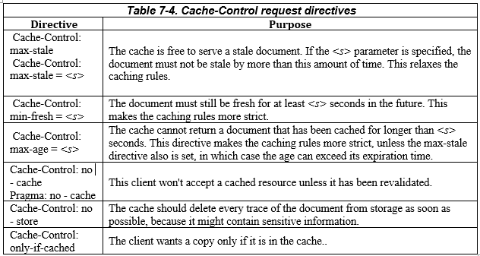
Chapter 7: Caching Controlling Cachability
7.9.6 Client Freshness Constraints
- Web browsers have a Refresh or Reload button to forcibly refresh content, which might be stale in the browser or proxy caches. The Refresh button issues a GET request with additional Cache-control request headers that force a revalidation or unconditional fetch from the server.

Slide 7
Chapter 7: Caching Controlling Cachability
7.9.7 Cautions
- Document expiration isn't a perfect system. If a publisher accidentally assigns an expiration date too far in the future, any document changes she needs to make won't necessarily show up in all caches until the document has expired.[17] For this reason, many publishers don't use distant expiration dates. - Also, many publishers don't even use expiration dates, making it tough for caches to know how long the document will be fresh.

Slide 8
Chapter 7: Caching Setting Cache Controlls
7.10.1 Controlling HTTP Headers with Apache
- The Apache web server provides several mechanisms for setting HTTP cache-controlling headers. Many of these mechanisms are not enabled by default—you have to enable them (in some cases first obtaining Apache extension modules). - - Here is a brief description of some of the Apache features:
+ mod_headers <Files *.html> Header set Cache-control no-cache </Files> + mod_expires ExpiresDefault A3600 ExpiresDefault M86400 ExpiresDefault "access plus 1 week" ExpiresByType text/html "modification plus 2 days 6 hours 12 minutes" + mod_cern_meta

Slide 9
Chapter 7: Caching Setting Cache Controlls
7.10.2 Controlling HTML Caching Through HTTP-EQUIV
To make it easier for authors to assign HTTP header information to served HTML documents without interacting with web server configuration files, HTML 2.0 defined the <META HTTP-EQUIV> tag. This optional tag sits at the top of an HTML document and defines HTTP headers that should be associated with the document. Here is an example of a <META HTTP-EQUIV> tag set to mark the HTML document uncachable: <HTML> <HEAD> <TITLE>My Document</TITLE> <META HTTP-EQUIV="Cache-control" CONTENT="no-cache"> </HEAD> ...
However, some browsers do parse and adhere to HTTP-EQUIV tags in the HTML content, treating the embedded headers like real HTTP headers (Figure 7-17). This is unfortunate, because HTML browsers that do support HTTP-EQUIV may apply different cache-control rules than intervening proxy caches. This causes confusing cache expiration behavior.

Slide 10
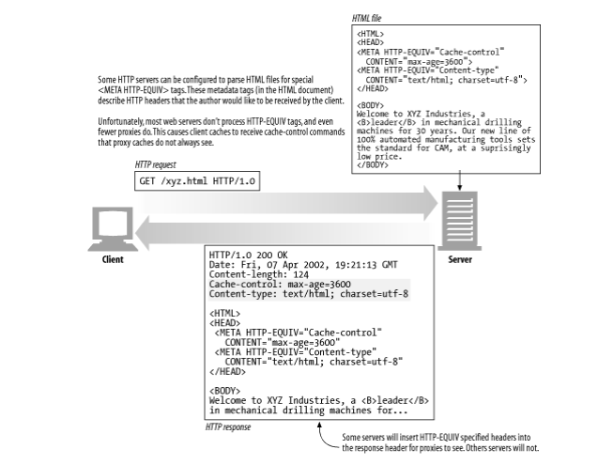
Chapter 7: Caching Setting Cache Controlls
Figure 7-17. HTTP-EQUIV tags cause problems, because most software ignores them

Slide 11
Chapter 7: Caching Detailed Algorithm
7.11.1 Age and Freshness Lifetime
To tell whether a cached document is fresh enough to serve, a cache needs to compute only two values: the cached copy's age and the cached copy's freshness lifetime. If the age of a cached copy is less than the freshness lifetime, the copy is fresh enough to serve. In Perl: $is_fresh_enough = ($age < $freshness_lifetime);
7.11.2 Age Computation
Example 7-1. HTTP/1.1 age-calculation algorithm calculates the overall age of a cached document $apparent_age = max(0, $time_got_response - $Date_header_value); $corrected_apparent_age = max($apparent_age, $Age_header_value); $response_delay_estimate = ($time_got_response - $time_issued_request); $age_when_document_arrived_at_our_cache = $corrected_apparent_age + $response_delay_estimate; $how_long_copy_has_been_in_our_cache = $current_time - $time_got_response; $age = $age_when_document_arrived_at_our_cache + $how_long_copy_has_been_in_our_cache;

Slide 12
Chapter 7: Caching Detailed Algorithm
Caches also can note how long the document has been sitting in the local cache. Summed together, these values are the entire age of the response. HTTP throws in some magic to attempt to compensate for clock skew and network delays, but the basic computation is simple enough: $age = $age_when_document_arrived_at_our_cache + $how_long_copy_has_been_in_our_cache;
7.11.2.1 Apparent age is based on the Date header - If all computers shared the same, exactly correct clock, the age of a cached document would simply be the "apparent age" of the document—the current time minus the time when the server sent the document. The server send time is simply the value of the Date header. The simplest initial age calculation would just use the apparent age: $apparent_age = $time_got_response - $Date_header_value; $age_when_document_arrived_at_our_cache = $apparent_age; - Unfortunately, not all clocks are well synchronized. The client and server clocks may differ by many minutes, or even by hours or days when clocks are set improperly.
- If the age is ever negative, we just set it to zero. We also could sanity check that the apparent age isn’t ridiculously large, but large apparent ages might actually be correct. We might be talking to a parent cache that has cached the document for a long time (the cache also stores the original Date header): $apparent_age = max(0, $time_got_response - $Date_header_value); $age_when_document_arrived_at_our_cache = $apparent_age;

Slide 13
Chapter 7: Caching Detailed Algorithm
7.11.2.2 Hop-by-hop age calculations So, we can eliminate negative ages caused by clock skew, but we can't do much about overall loss of accuracy due to clock skew. HTTP/1.1 attempts to work around the lack of universal synchronized clocks by asking each device to accumulate relative aging into an Age header, as a document passes through proxies and caches. This way, no cross-server, end-to-end clock comparisons are needed. The Age header value increases as the document passes through proxies. HTTP/1.1-aware applications should augment the Age header value by the time the document sat in each application and in network transit. Each intermediate application can easily compute the document's resident time by using its local clock. The relative age values are used in addition to the Date-based age calculation, and the most conservative of the two age estimates is chosen, because either the cross-server Date value or the Agecomputed value may be an underestimate (the most conservative is the oldest age). This way, HTTP tolerates errors in Age headers as well, while erring on the side of fresher content: $apparent_age = max(0, $time_got_response - $Date_header_value); $corrected_apparent_age = max($apparent_age, $Age_header_value); $age_when_document_arrived_at_our_cache = $corrected_apparent_age;

Slide 14
Chapter 7: Caching Detailed Algorithm
7.11.2.3 Compensating for network delays
Transactions can be slow. This is the major motivation for caching. But for very slow networks, or overloaded servers, the relative age calculation may significantly underestimate the age of documents if the documents spend a long time stuck in network or server traffic jams.
There is no easy way to measure one-way network delay from server to cache, but it is easier to measure the round-trip delay. A cache knows when it requested the document and when it arrived. HTTP/1.1 conservatively corrects for these network delays by adding the entire round-trip delay. This cache-to-server-to-cache delay is an overestimate of the server-to-cache delay, but it is conservative. If it is in error, it will only make the documents appear older than they really are and cause unnecessary revalidations. Here's how the calculation is made: $apparent_age = max(0, $time_got_response - $Date_header_value); $corrected_apparent_age = max($apparent_age, $Age_header_value); $response_delay_estimate = ($time_got_response - $time_issued_request); $age_when_document_arrived_at_our_cache = $corrected_apparent_age + $response_delay_estimate;

Slide 15
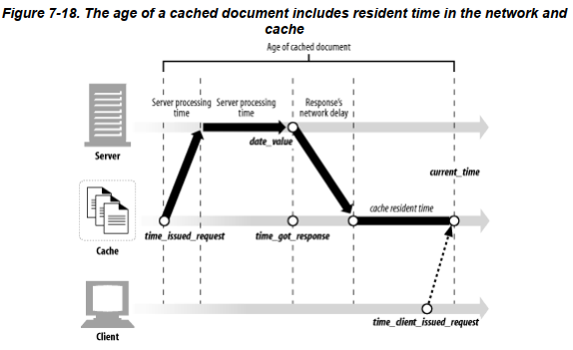
Chapter 7: Caching Detailed Algorithm
7.11.3 Complete Age-Calculation Algorithm - The last section showed how to compute the age of an HTTP-carried document when it arrives at a cache. Once this response is stored in the cache, it ages further. When a request arrives for the document in the cache, we need to know how long the document has been resident in the cache, so we can compute the current document age: $age = $age_when_document_arrived_at_our_cache + $how_long_copy_has_been_in_our_cache;

Slide 16
Chapter 7: Caching Detailed Algorithm
7.11.4 Freshness Lifetime Computation - Recall that we're trying to figure out whether a cached document is fresh enough to serve to a client.To answer this question, we must determine the age of the cached document and compute the freshness lifetime based on server and client constraints. We just explained how to compute the age; now let's move on to freshness lifetimes.
- The freshness lifetime of a document tells how old a document is allowed to get before it is no longer fresh enough to serve to a particular client. The freshness lifetime depends on server and client constraints. The server may have information about the publication change rate of the document. Very stable, filed reports may stay fresh for years. Periodicals may be up-to-date only for the time remaining until the next scheduled publication—next week, or 6:00 am tomorrow. - Clients may have certain other guidelines. They may be willing to accept slightly stale content, if it is faster, or they might need the most up-to-date content possible. Caches serve the users. We must adhere to their requests.

Slide 17
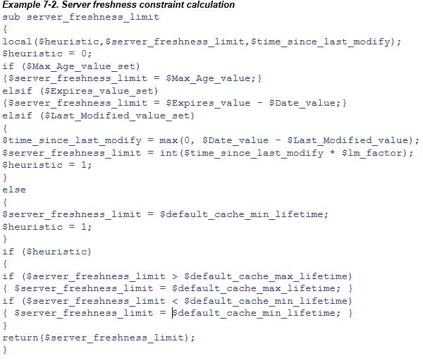
Chapter 7: Caching Detailed Algorithm
7.11.5 Complete Server-Freshness Algorithm
Example 7-2 shows a Perl algorithm to compute server freshness limits. It returns the maximum age that a document can reach and still be served by the server.

Slide 18
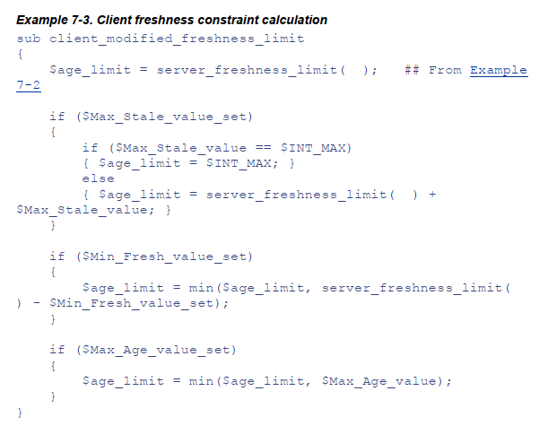
Chapter 7: Caching Detailed Algorithm
Now let's look at how the client can override the document's server-specified age limit. Example 7-3 shows a Perl algorithm to take a server freshness limit and modify it by the client constraints. It returns the maximum age that a document can reach and still be served by the cache without revalidation.

Slide 19
Chapter 7: Caching Caches and Advertising
7.12.1 The Advertiser's Dilemma - You might also expect content providers to like caches. After all, if caches were everywhere, content providers wouldn't have to buy big multiprocessor web servers to keep up with demand—and they wouldn't have to pay steep network service charges to feed the same data to their viewers over and over again. And better yet, caches make the flashy articles and advertisements show up even faster and look even better on the viewer's screens, encouraging them to consume more content and see more advertisements. And that's just what content providers want! More eyeballs and more advertisements!
7.12.2 The Publisher's Response - Today, advertisers use all sorts of "cache-busting" techniques to ensure that caches don't steal their hit stream. They slap no-cache headers on their content. They serve advertisements through CGI gateways. They rewrite advertisement URLs on each access. - And these cache-busting techniques aren't just for proxy caches. In fact, today they are targeted primarily at the cache that's enabled in every web browser. Unfortunately, while over-aggressively trying to maintain their hit stream, some content providers are reducing the positive effects of caching to their site. One solution is to configure caches to revalidate with the origin server on every access. This pushes a hit to the origin server for each access but usually does not transfer any body data. Of course, this slows down the transaction.

Slide 20
Chapter 7: Caching Caches and Advertising
7.12.3 Log Migration - One ideal solution wouldn't require sending hits through to the server. After all, the cache can keep a log of all the hits. Caches could just distribute the hit logs to servers. In fact, some large cache providers have been know to manually process and hand-deliver cache logs to influential content providers to keep the content providers happy. - Unfortunately, hit logs are large, which makes them tough to move. And cache logs are not standardized or organized to separate logs out to individual content providers. Also, there are authentication and privacy issues. - Proposals have been made for efficient (and less efficient) log-redistribution schemes. None are far enough developed to be adopted by web software vendors. Many are extremely complex and require joint business partnerships to succeed.[23] Several corporate ventures have been launched to develop supporting infrastructure for advertising revenue reclamation.
7.12.4 Hit Metering and Usage Limiting - RFC 2227, "Simple Hit-Metering and Usage-Limiting for HTTP," defines a much simpler scheme. This protocol adds one new header to HTTP, called Meter, that periodically carries hit counts for particular URLs back to the servers. This way, servers get periodic updates from caches about the number of times cached documents were hit. - In addition, the server can control how many times documents can be served from cache, or a wall clock timeout, before the cache must report back to the server. This is called usage limiting; it allows servers to control the how much a cached resource can be used before it needs to report back to the origin server.

